Slide 1
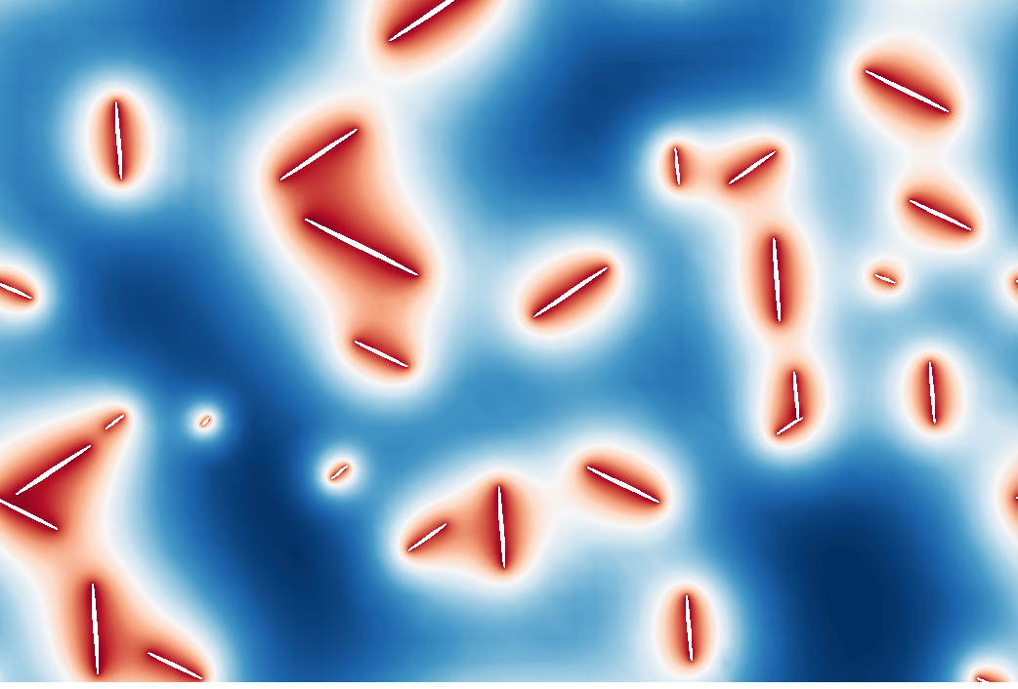
The PRISMS Phase Field Code
Trainers:
Steve DeWitt (PRISMS-PF Lead Developer)
Beck Andrews
David Montiel

Slide 2
Training Objective
Learn enough of PRISMS-PF to allow you to go home and start using it in your work

Slide 3
Plan for the Training
Schedule:
Brief introductory comments
Guided walkthrough
Tour of the file system
Running example applications
Visualization
Tutorial on writing equations in the weak form
Walkthrough of the application files
Brief tutorial on the new plugin for the Materials Commons CLI
Individual exercises using PRISMS-PF to modify existing applications and create new applications
Now
This morning
This afternoon
and
Wednesday

Slide 4
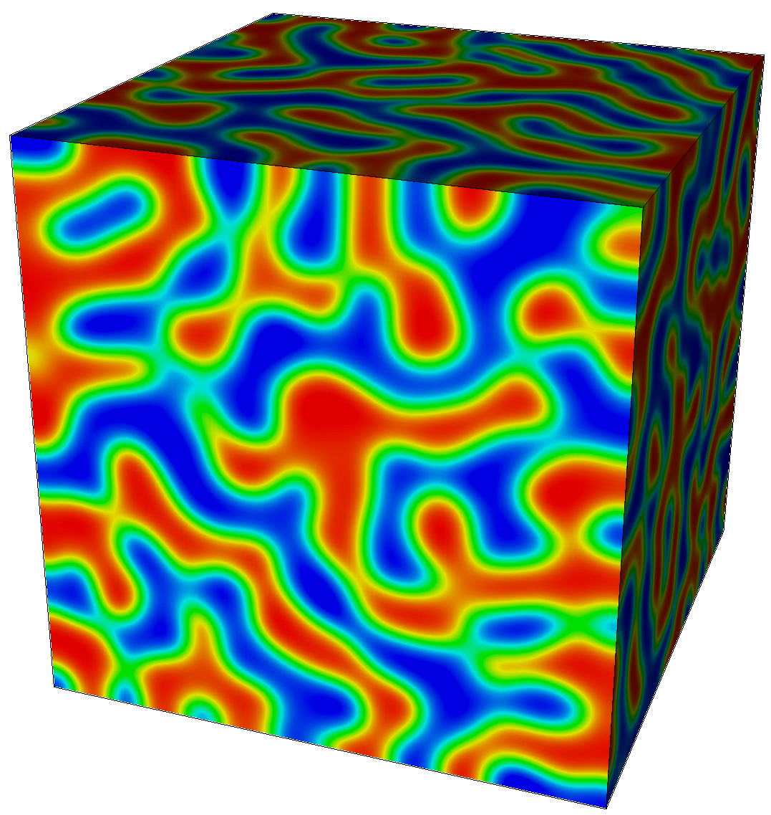
One Slide on Phase Field Modeling
Diffuse interface approach to modeling microstructure evolution
Used to study phase separation in systems with 2+ free energy minima
Evolution equations derived from a free energy functional
May or may not have a physical basis
Applications include:
solidification, precipitation, grain growth, phase separation in batteries, deposition, ferroics
Allen-Cahn Equation
(non-conserved dynamics)
Cahn-Hilliard Equation
(conserved dynamics)
Spinodal Decomposition
(Cahn-Hilliard Equation)

Slide 5
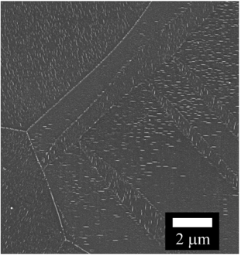
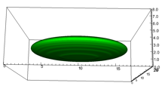
Motivation and Requirements for the PRISMS Phase Field Code
Microstructure simulations often require very large calculations
These are terascale computational problems with 10⁶ to 10⁹ DOF
For grain growth, need the ability to track 100s of grains
Many different governing equations fall under the umbrella of “phase field modeling”, need flexibility
Finite Element Method
Easily allows mesh adaptivity, arbitrary geometries, and high order of accuracy
Can build from well-established community codes (e.g. deal.II)
Allows a shared toolset with PRISMS-Plasticity and PRISMS-RSDFT
However, need a low memory approach to compete with finite difference
5

Slide 6
Four Principles Guiding PRISMS-PF Development
Its computational performance, including parallel scalability, should meet or exceed that of typical phase field codes
It should accommodate a wide variety of phase field models and applications
The interface for creating or modifying governing equations should be simple, quick, and separate from the numerics
It should be open source with a permission license so it is available to everyone and can be modified and improved

Slide 7
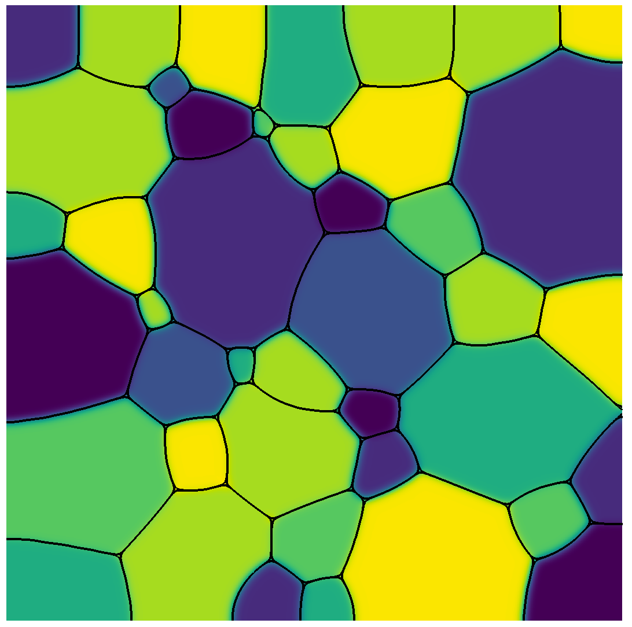
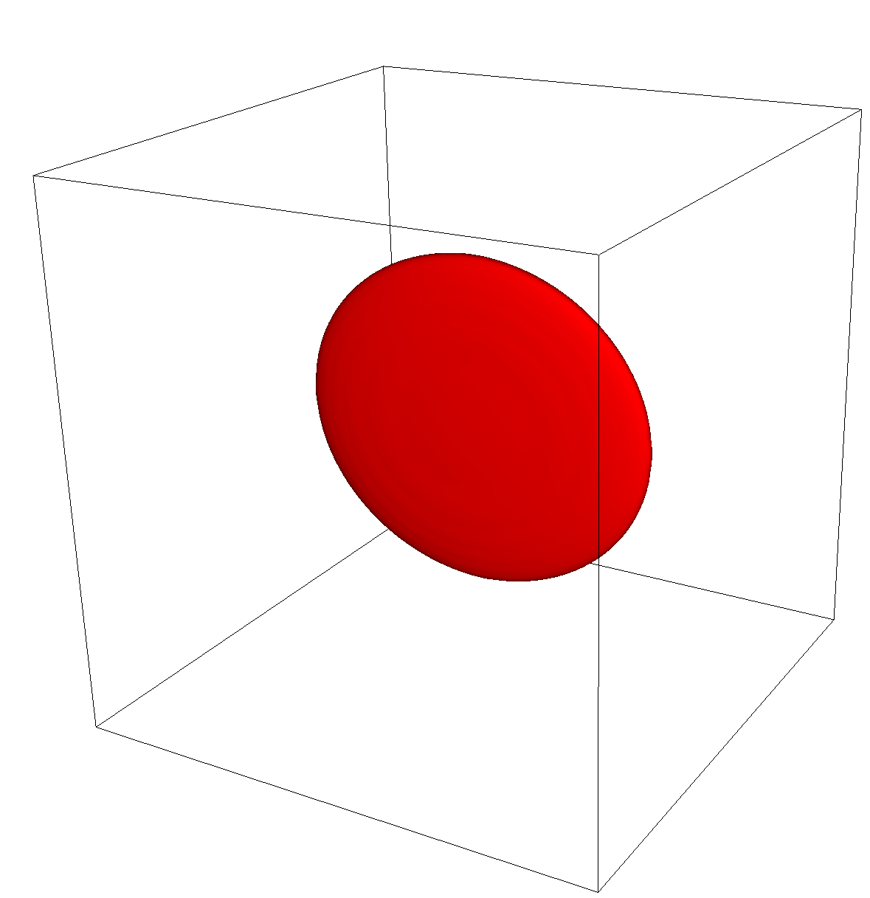
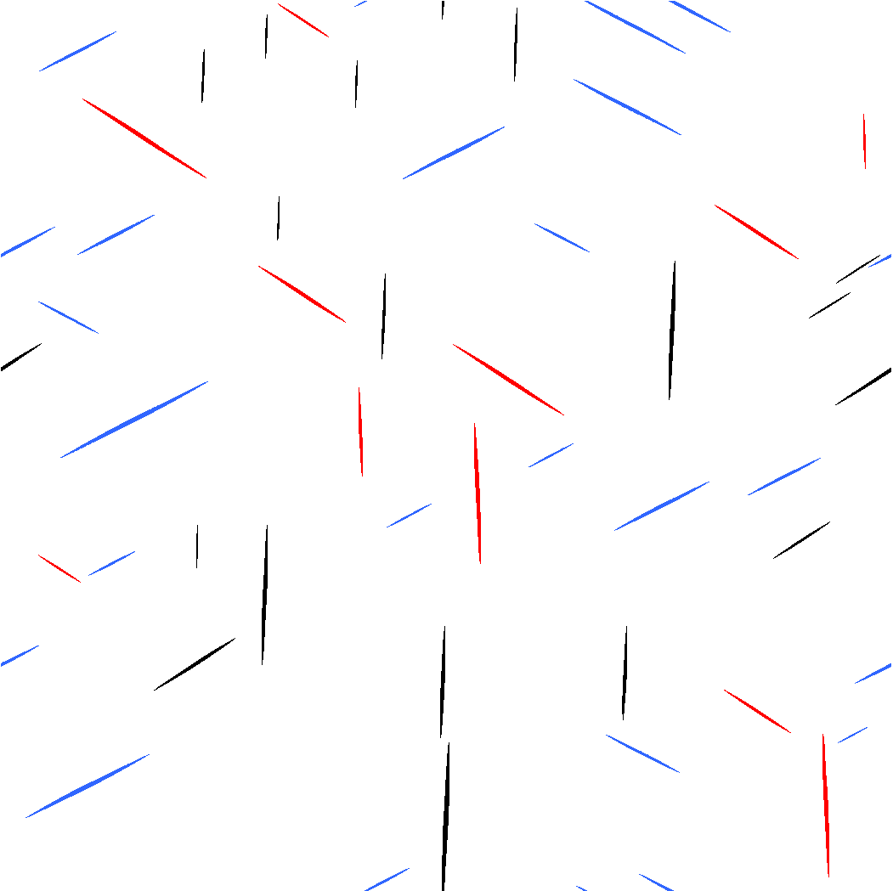

An Open Source, Finite Element,
General Purpose Phase-Field Platform
(github.com/prisms-center/phaseField)
Advanced Capabilities:
Matrix-free finite element approach
High-order elements
Hybrid parallelization: MPI/Threads/Vectorization
Adaptive meshing
Explicit nucleus placement
Grain-remapping
High-Performance:
Ideal scaling for >1,000 processors
Improved performance with finite difference (10x without adaptive meshing, 100x with adaptive meshing)
User-Friendly:
Simple interface to solve an arbitrary number of coupled PDEs
Detailed online user guide
24 applications to get you started
Simple Docker-based installation

Slide 8
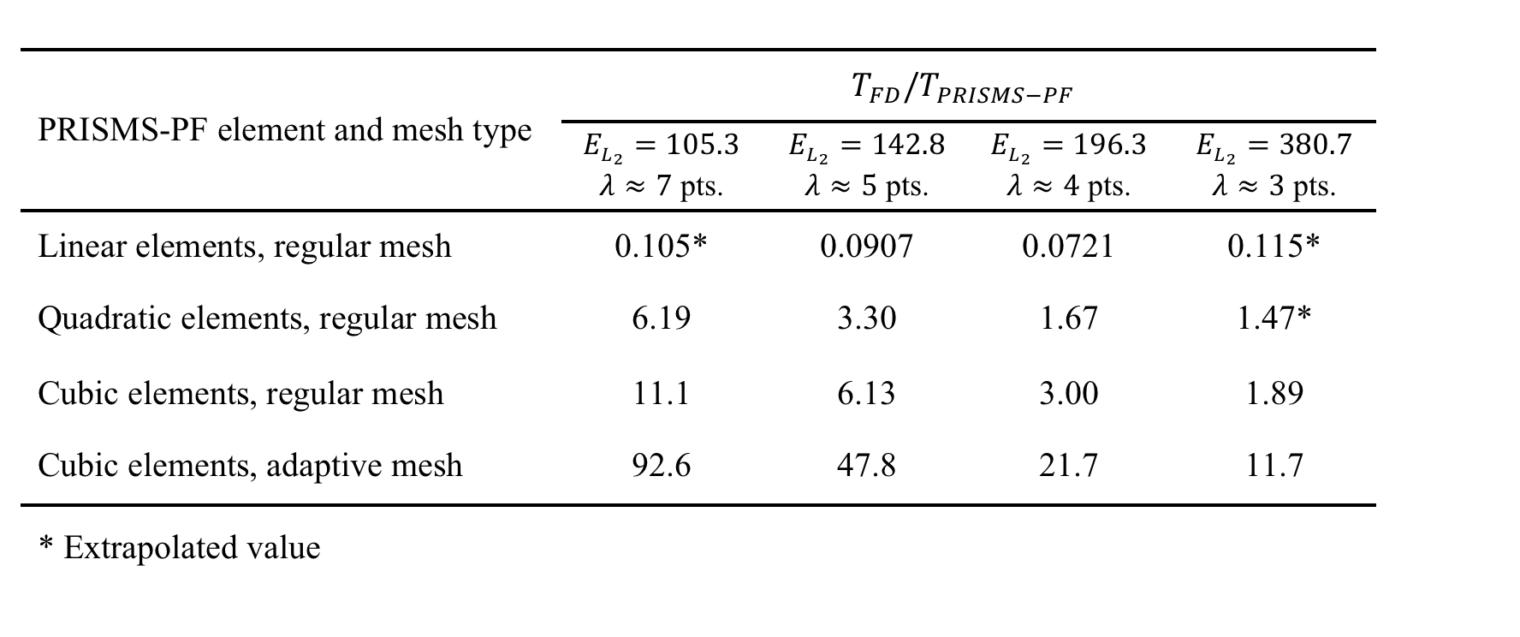
Performance vs. Finite Difference
Test Problem: Coupled Cahn-Hilliard/Allen-Cahn, 2 growing spheres
Comparison Code: Custom FD code written in Fortran w/ MPI

Slide 9
Structure of PRISMS-PF
Core library
Generates mesh, does the finite element calculation, outputs files, etc.
Apps
Each app is a directory that contains an input file and some application files
Governing equations, boundary conditions, initial conditions, numerical and model parameters, postprocessing expressions
Copy and paste an app directory to create a new app
Tests
Suite of unit and regression tests

Slide 10
Three Types of PRISMS-PF Users
Uses PRISMS-PF applications
No C++ knowledge needed
No deal.II knowledge needed
Creates PRISMS-PF applications
Minimal C++ knowledge needed
No deal.II knowledge needed
Extends PRISMS-PF itself
C++ knowledge needed
deal.II knowledge needed

Slide 11
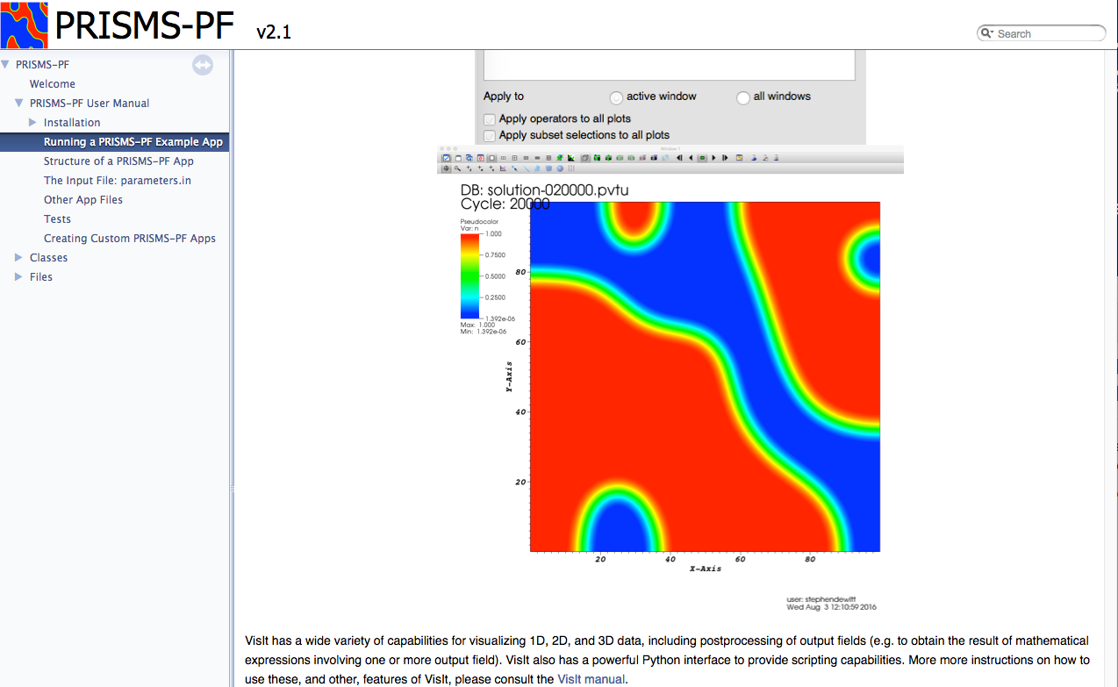
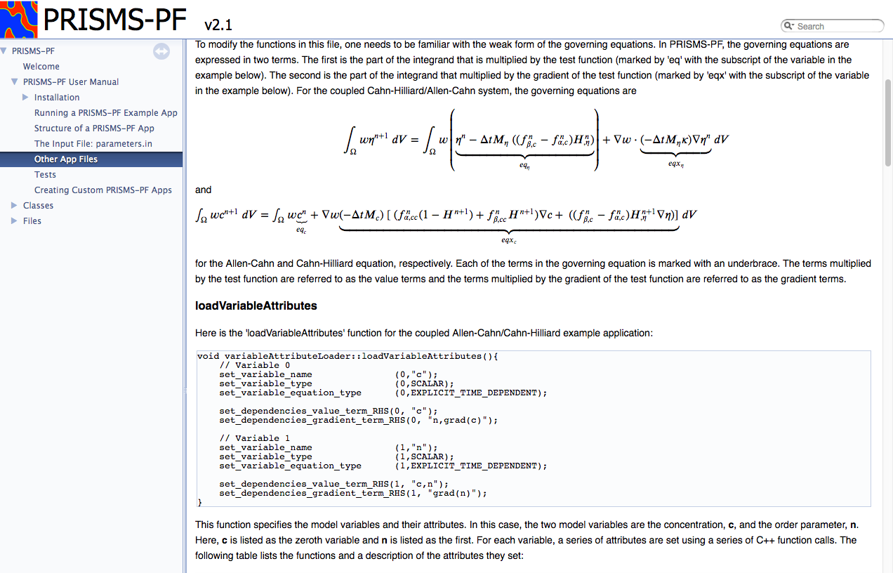
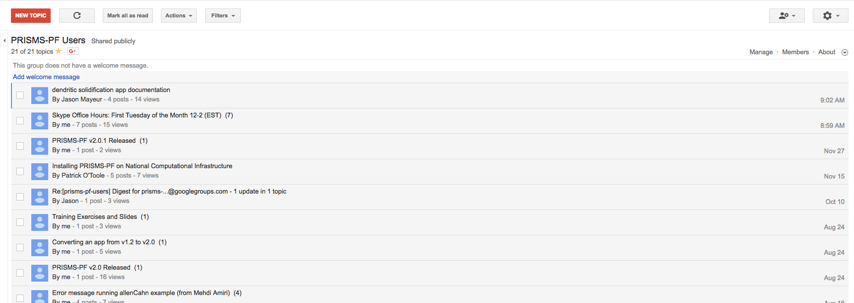

Community Support
Online user manual
Online forum
Monthly Skype office hours

Slide 12
Questions?

Slide 13
Downloading PRISMS-PF
https://github.com/prisms-center/phaseField

Slide 14
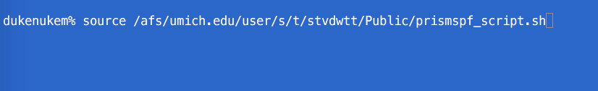
Setting Environment Variables
Type this on the command line:
source /afs/umich.edu/user/s/t/stvdwtt/Public/prismspf_script.sh

Slide 16
Installing the Materials Commons Command Line Interface Tool
Type this on the command line:
source /afs/umich.edu/user/s/t/stvdwtt/Public/install_mccli.sh

Slide 17
Cloning a Materials Commons Project
Create a directory for your Materials Commons projects and enter it
$ mkdir mc_projects
$ cd mc_projects
View current Materials Commons projects
$ mc proj
Clone the project to your local machine
$mc clone [id of the project]

Slide 18
Creating a New Dataset
Enter the project directory
$ cd [project name]
Copy a PRISMS-PF app directory here
Either using ‘cp’ or the GUI
Enter that directory
$ cp [app name]
Parse the input files and upload the results
$ mc prismspf simulation --create --full-simulation --proc-name Dendritic Solidification --num-cores 8

